Slide 1
Meta Learning
By: Chandresh Kumar Maurya,
CSE deptt, IIT Indore
Some Slides adapted from Chelsea Finn Talk on Meta learning Tutorial

Slide 2
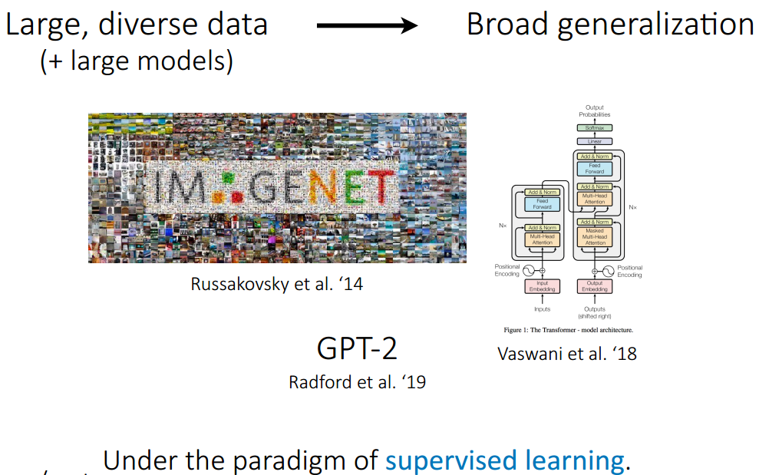

Slide 3
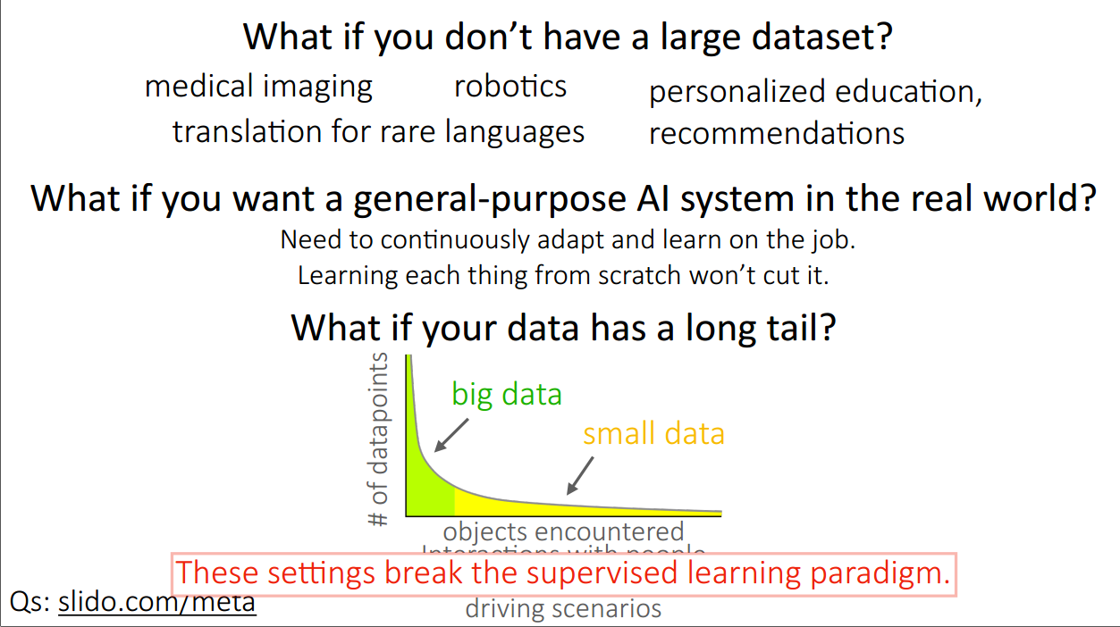

Slide 4
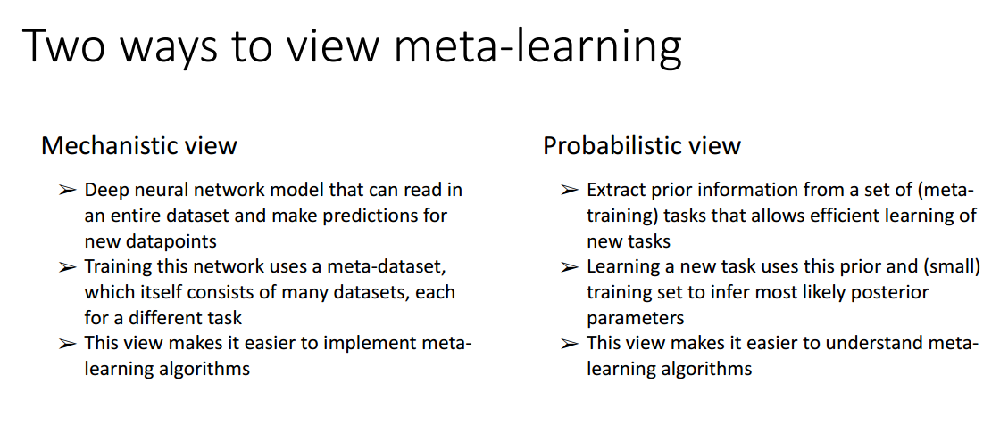

Slide 5
Problems with Current AI models
They are data hungry
Everytime you want to deploy model M trained on task A to for solving task B which is closely related to task A, you suffer with:
Low performance
Have to retrain from scratch
Is this really a true AI model?

Slide 6
Problems with Current AI models
They are data hungry
Everytime you want to deploy model M trained on task A to for solving task B which is closely related to task A, you suffer with:
Low performance
Have to retrain from scratch
Is this really a true AI model?
No.
How do as a human learn?
We generalize our learning from one task to multiple tasks.
Current learning algorithm master only one task.
This is where meta learning comes in.

Slide 7
What is Meta Learning
Meta learning produces a versatile AI model that can learn to perform various tasks without having to train them from scratch.
We train our meta learning model on various related tasks with few data points, so for a new related task, it can make use of the learning obtained from the previous tasks and we don't have to train them from scratch.
Many researchers and scientists believe that meta learning can get us closer to achieving artificial general intelligence (AGI)

Slide 8
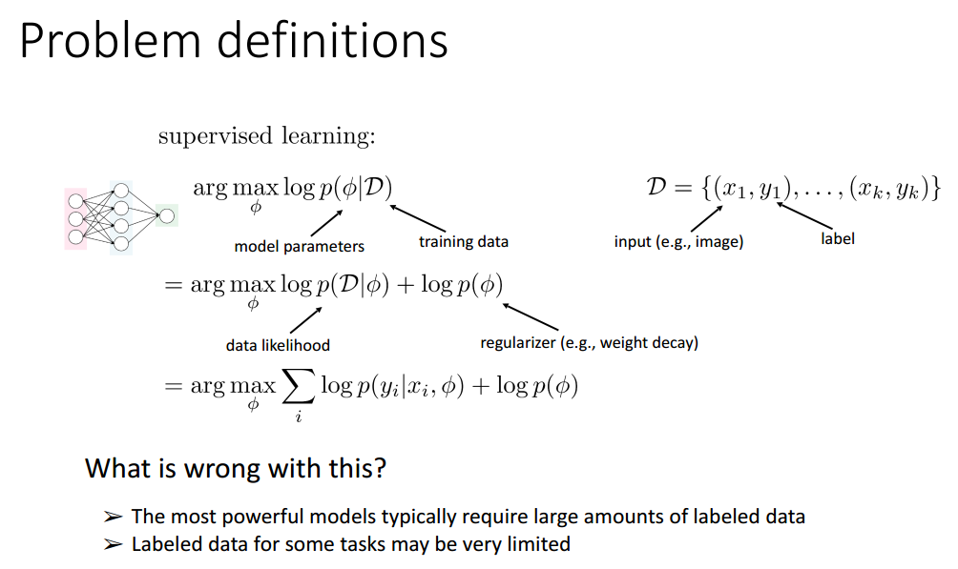

Slide 9
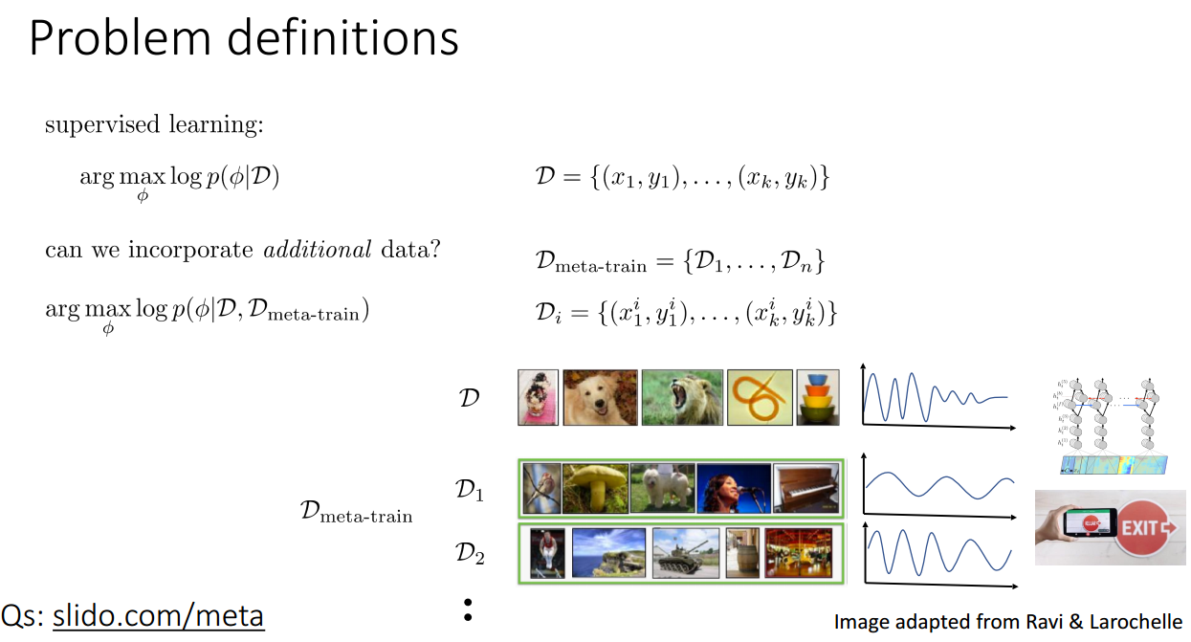

Slide 10
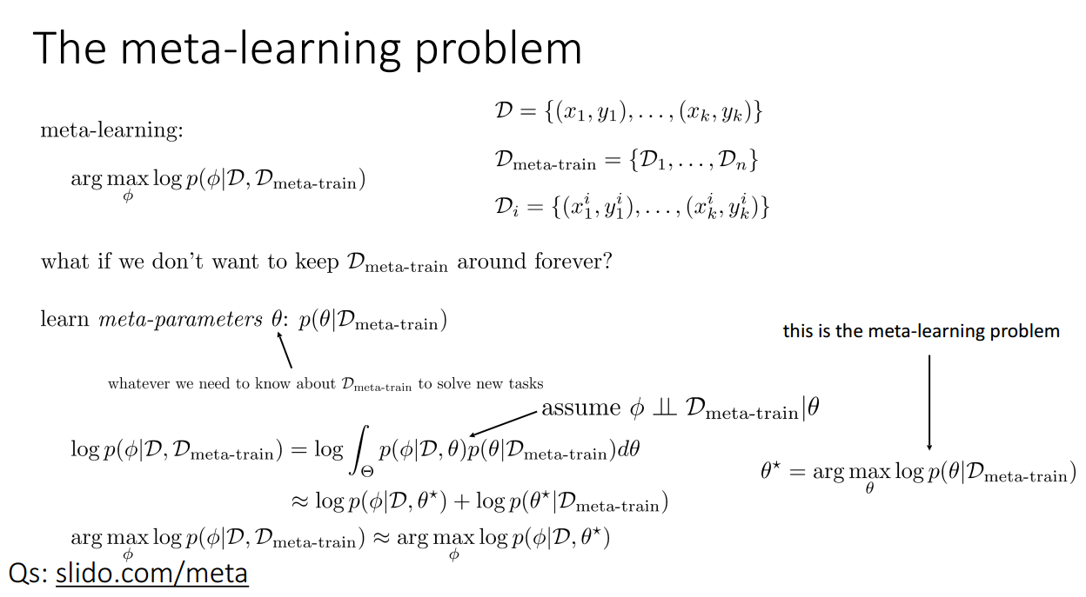

Slide 11
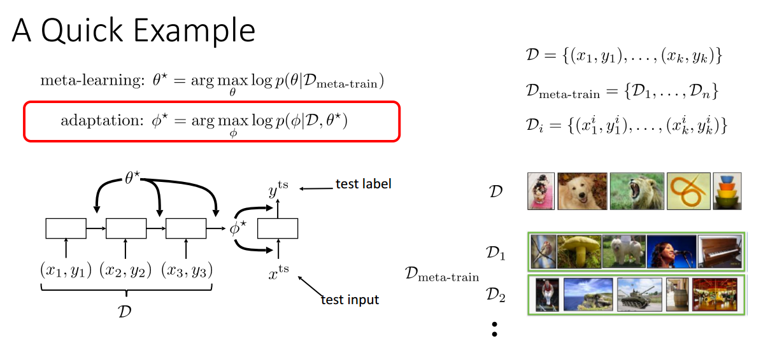

Slide 12
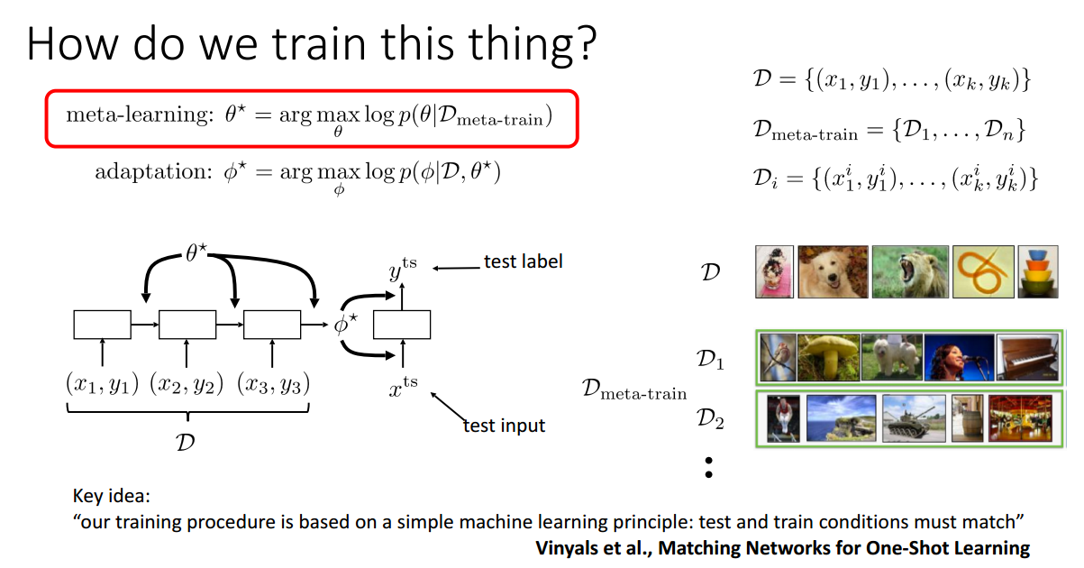

Slide 13
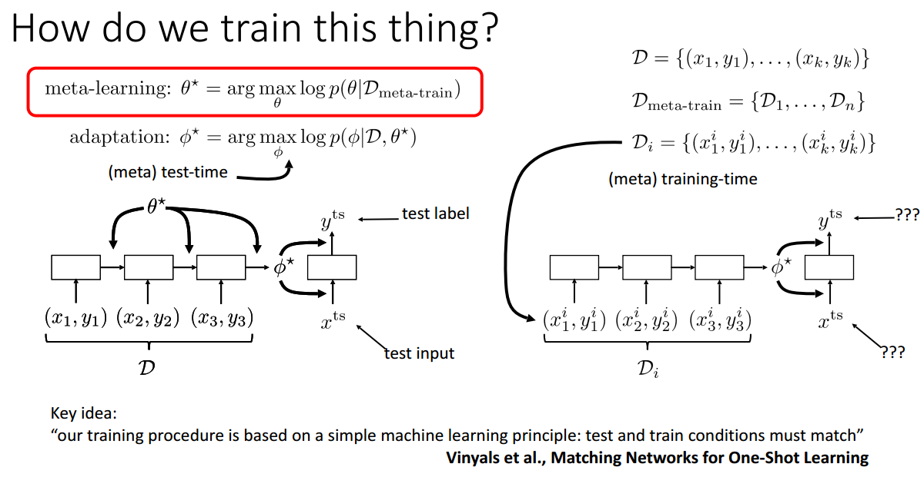

Slide 14
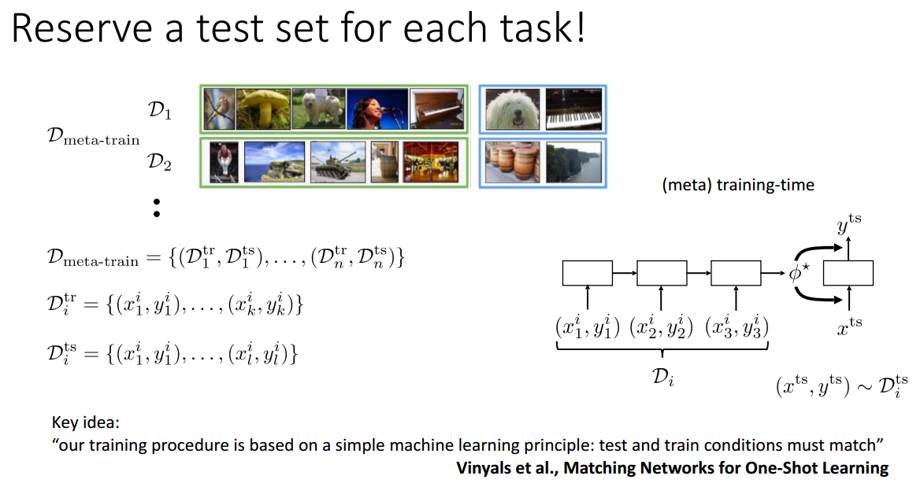

Slide 15
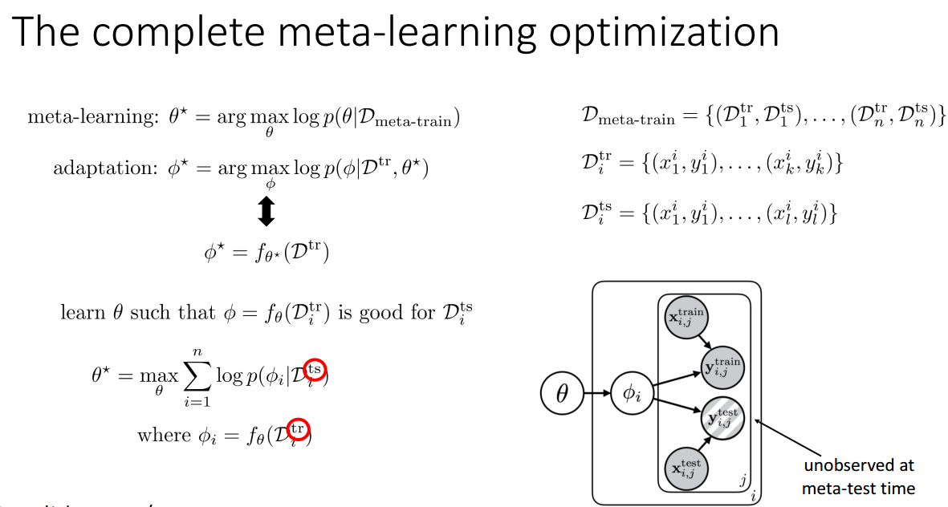

Slide 16
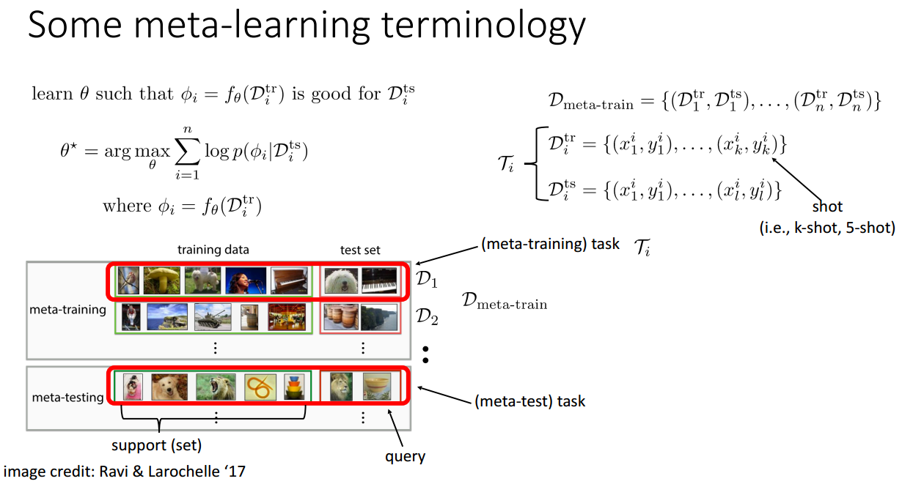

Slide 17
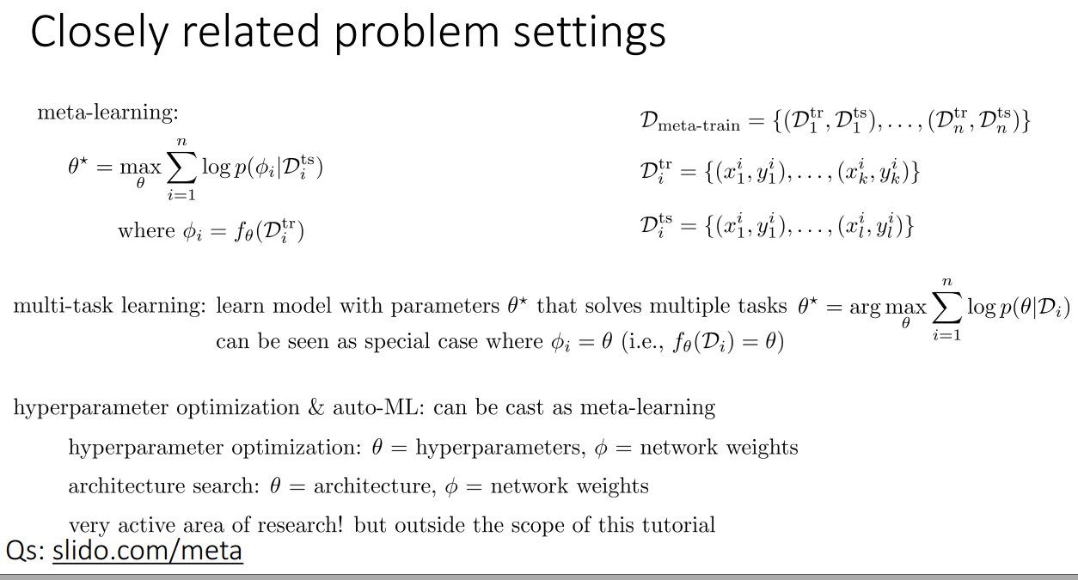

Slide 18
Closely Related Problem Settings
Transfer Learning
Multi-task learning in which we learn multiple tasks T1,T2,..,Tn together
Fine-tuning in which we take a pretrained model and tune to work in target domain. E.g. Imagenet fine tuning on medical data
Domain adaptation similar to fine tuning except that only domain changes, not the labels
Meta learning
A form of lifelong learning in which we learn a model on multiple related tasks and test on a different but related task where we have very less data. Recently, meta-learning tends focus on finding "model agnostic" solutions where as multi-task learning remains deeply tied to model architecture.

Slide 19
Some More Terminology
K-shot learning : use k examples to learn the task
Special cases:
Zero-shot learning: k=0
One-shot learning: k=1
Few-shot learning: aka k-shot learning
How can we learn when there are no data points at all?
In this case, we will not have data points, but we will have meta information about each of the classes and we will learn from the meta information.

Slide 20
Types of meta learning
Learning the metric space
Learning the initializations
Learning the optimizer

Slide 21
Learning the metric space
learn the appropriate metric space.
Let's say we want to learn the similarity between two images.
In the metric-based setting, we use a simple neural network that extracts the features from two images and finds the similarity by computing the distance between features of these two images.
This approach is widely used in a few-shot learning setting where we don't have many data points.
Example of metric-based learning algorithms are Siamese networks, prototypical networks, and relation networks.

Slide 22
Learning the Initializations
learn optimal initial parameter values.
Let's say we are a building a neural network to classify images.
First, we initialize random weights, calculate loss, and minimize the loss through a gradient descent.
Instead of initializing the weights randomly, if can we initialize the weights with optimal values or close to optimal values, then we can attain the convergence faster and we can learn very quickly.
Algorithms such as MAML, Reptile, and Meta-SGD.

Slide 23
Learning the optimizer
Try to learn the optimizer.
How do we generally optimize our neural network?
We optimize our neural network by training on a large dataset and minimize the loss using gradient descent.
But in the few-shot learning setting, gradient descent fails as we will have a smaller dataset.
So, in this case, we will learn the optimizer itself.
Have two networks: a base network that actually tries to learn and a meta network that optimizes the base network.

Slide 24
Learning the Metric Space: Siamese Network: One-shot learning of faces
Siamese network is type of NN where two symmetrical networks sharing the same weights and architecture are joined together at the end using some energy function.
The objective of our siamese network is to learn whether two input values are similar or dissimilar.
Let's say we have two images, X1 and X2, and we want to learn whether the two images are similar or dissimilar

Slide 25
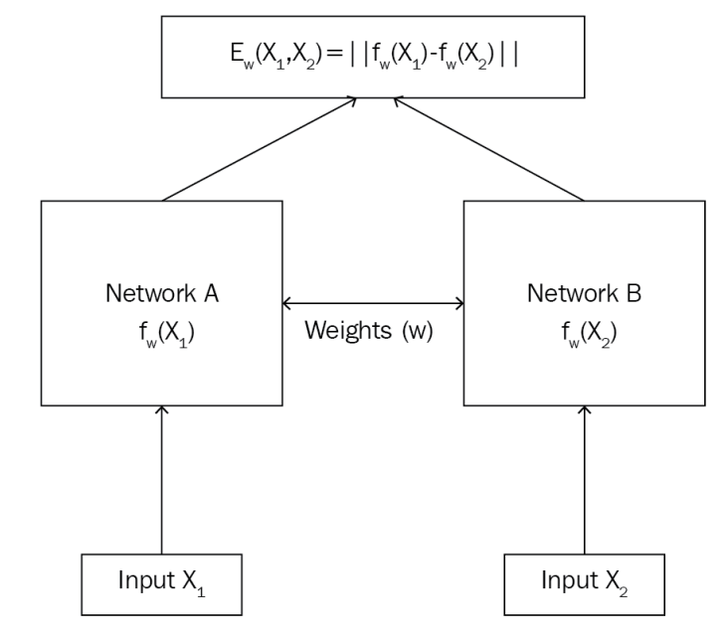
Siamese Network: few-shot learning of faces
See 02 face and audio recognition folder for code.

Slide 26
Learning the Initializers: Modal Agnostic Meta Learning ( MAML)
MAML is one of the recently introduced and most popularly used meta learning algorithms.
Major breakthrough in meta learning research.
Learning to learn is the key focus of meta learning
In meta learning, we learn from various related tasks containing only a small number of data points and the meta learner produces a quick learner that can generalize well on a new related task even with a lesser number of training samples.

Slide 27
MAML
The basic idea of MAML is to find a better initial parameter so that, with good initial parameters, the model can learn quickly on new tasks with fewer gradient steps.
In NN, we learn by optimizing the loss using gradient descent.
Gradient descent gives us the optimal weights.
In MAML, we try to find these optimal weights by learning from the distribution of similar tasks.
So, for a new task, we don't have to start with randomly initialized weights—instead, we can start with optimal weights, which will take fewer gradient steps to reach convergence and it doesn't require more data points for training.

Slide 28
Intuition
We have three related tasks: T1, T2, and T3
First, we randomly initialize our model parameter, θ. We train our network on task T1.
Then, we try to minimize the loss L by gradient descent. We minimize the loss by finding the optimal parameter θ1*.
Similarly, for tasks T2 and T3, we will start off with a randomly initialized model parameter, θ, and minimize the loss by finding the right set of parameters by gradient descent.
Let's say θ2*, θ3* are the optimal parameters for the tasks, T2 and T3, respectively.

Slide 29
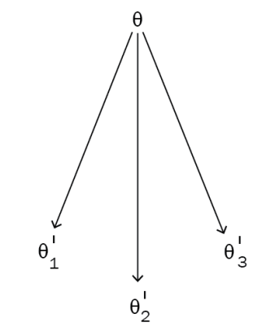

Slide 30
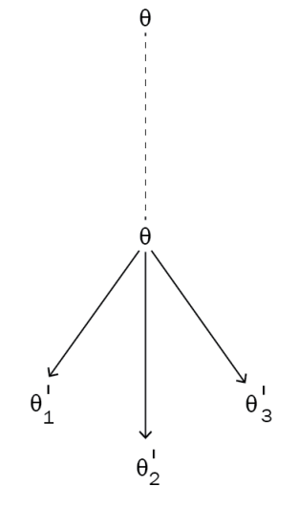

Slide 31
So, for a new related task, say, T4, we don't have to start with a randomly initialized parameter, θ. Instead, we can start with the optimal θ value so that it will take fewer gradient steps to attain convergence.
MAML is model agnostic, meaning that we can apply MAML to any models that are trainable with gradient descent. But how exactly does MAML work?
How do we shift the model parameters to an optimal position?

Slide 32
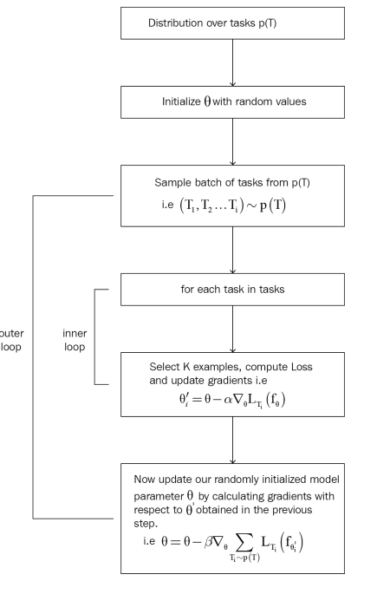
MAML in Detail

Slide 33
See the demo of MAML in python notebook

Slide 34
Ideas on Improving MAML?

Slide 35
Task-Agnostic Meta Learning (TAML)
In meta learning, we sample a batch of tasks and from each batch sample a data points and train the model on it.
Do you see any problem in this?

Slide 36
Task-Agnostic Meta Learning (TAML)
In meta learning, we sample a batch of tasks and from each batch sample a data points and train the model on it.
Do you see any problem in this?
Model could be biased towards task sampled more often than others.
Need a model which generalizes over unseen tasks which vary widely with the training tasks
Need our model task-agnostic.

Slide 37
TAML
Entropy maximization/reduction
Inequality minimization

Slide 38
Entropy Maximization/Minimization
Goal: Learn task-agnostic models
We know that entropy is a measure of randomness. So, we maximize entropy by allowing the model to make a random guess over the predicted labels with equal probability.
By making random guesses over the predicted label, we can prevent task bias.

Slide 39
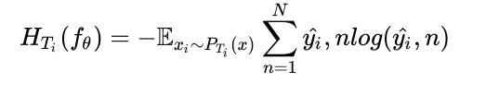
Entropy Calculation
How do we compute the entropy?
Let's denote entropy by H. The entropy for Ti computed by sampling from xi over its output probabilities from PTi(xi), over predicted labels:

Slide 40

Contd..
Maximize the entropy before updating the model parameter.
Next, we minimize the entropy after updating the model parameter.
So, what do we mean by minimizing the entropy?
Minimizing the entropy implies that we don't add any randomness over the predicted labels and we allow the model to predict the label with high confidence.
So, our goal is to maximize the entropy reduction for each of the tasks and it can be represented as follows:

Slide 41

Contd..
Incorporate our entropy term with the meta objective and try to find the optimal parameter , so our meta objective becomes the following:

Slide 42
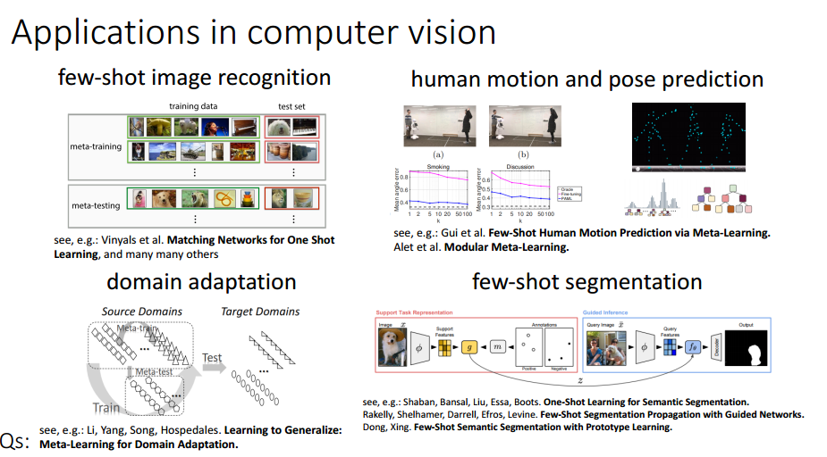
Applications of Meta learning

Slide 43
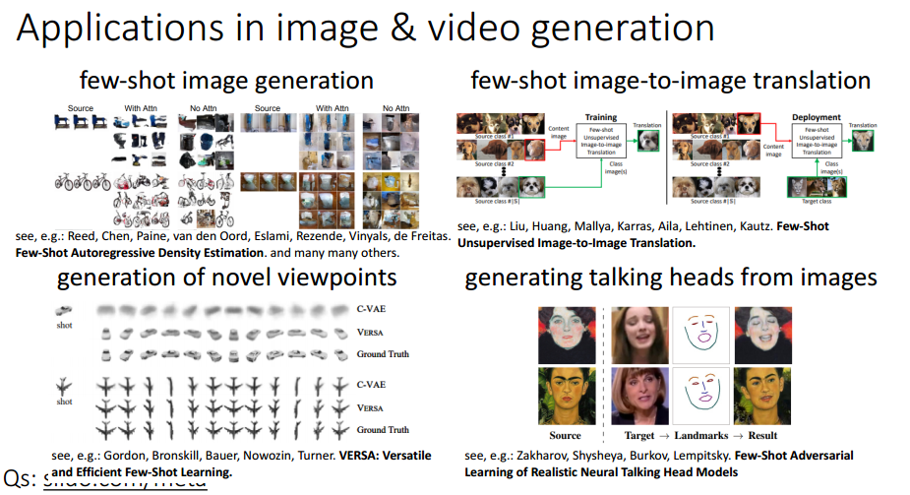
Applications of Meta learning

